Slide 1

Mobile Development with Xamarin
Mike Brocchi
@brocco
mbrocchi@gmail.com

Slide 2
Why Multiplatform?
More platforms
More users
More money
How many more…

Slide 3
As of 11/2013
http://www.cnet.com/news/iphone-market-share-shrinks-as-android-windows-phone-grow/

Slide 4
Technology
Windows Phone | Android | iOS
C# | Java | Objective C
XAML | Android XML (AXML) | Cocoa Touch

Slide 5
Technology w/ Xamarin
Windows Phone | Android | iOS
C# | Java C# | Objective C C#
XAML | Android XML (AXML) | Cocoa Touch

Slide 6


How does it work
Open source compiler
Derived from Mono Touch and Mono Droid
Xamarin Development Studio
Visual Studio Integration

Slide 7
Why does it work
Single code base
Write once use multiple times
Same code in multiple environments

Slide 8
How to share code
Copy files
Linked files
Portable Class Libraries (PCL)
Good
Better
Best

Slide 9
What code should I share?
Business logic
Calculations
List Filtering
Service interfaces
http
Local database access (SQLLite)

Slide 10
What code should I not share?
UI logic
Events (button clicks)
Navigation (screen transitions)

Slide 11
Why not mobile web?
Platforms have their own “style language”
Users want consistency across apps
Runs natively on device (performance)

Slide 12
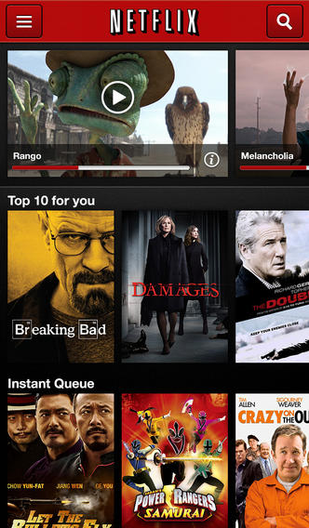
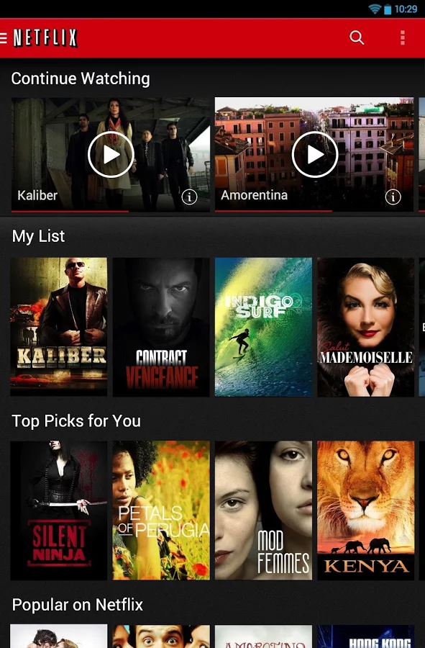
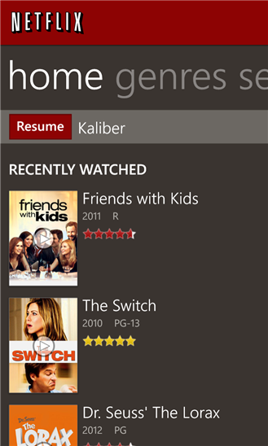
Netflix (iOS, Android, WP8)

Slide 13

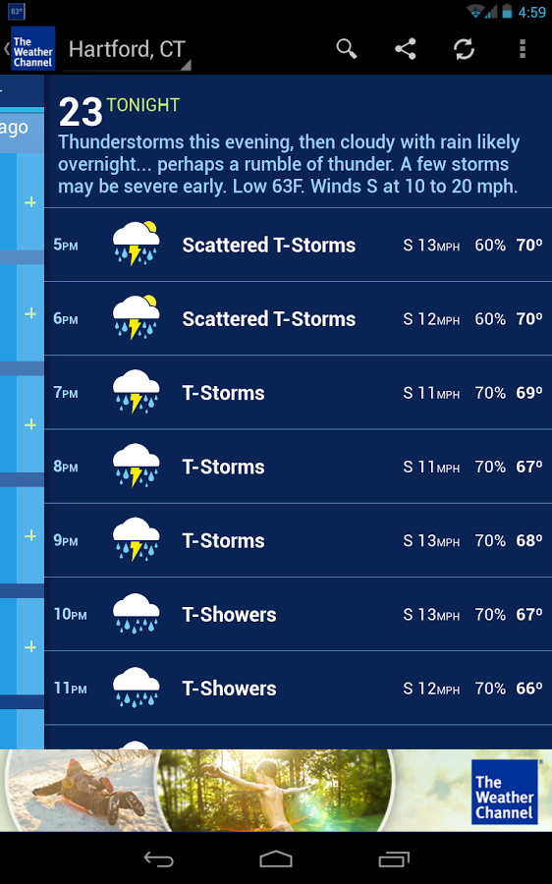
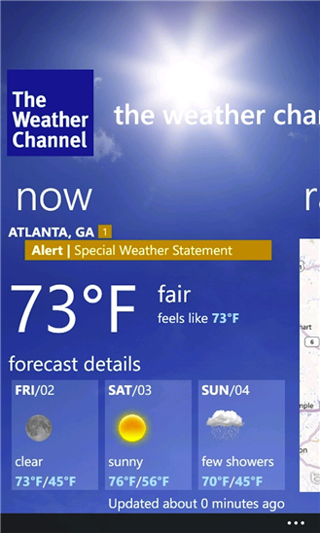
Weather Channel (iOS, Android, WP8)

Slide 14
Why not Xamarin
Cost
Cost
Cost
To do iOS you still need a Mac
Its expensive!!!

Slide 15
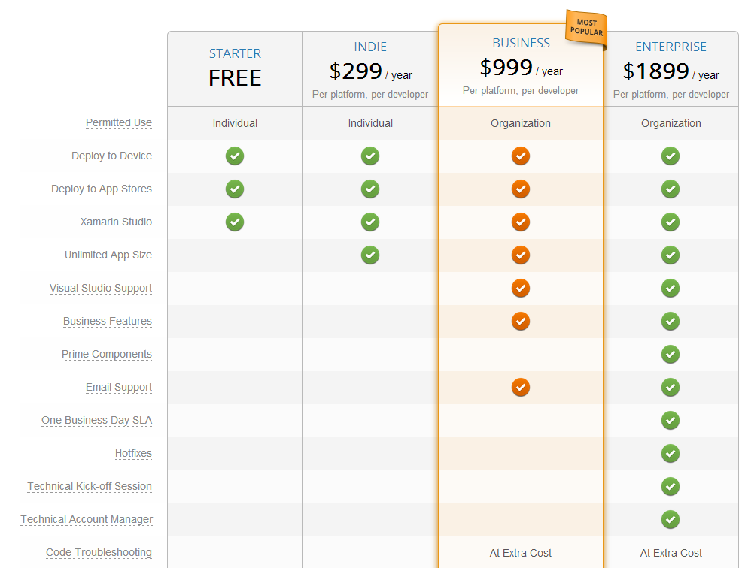

Slide 16
DEMO TIME
Dear demo gods,
Please be kind to me
-Mike

Slide 17
Hey idiot, demo time, not next slide time

Slide 18
Questions
“There are no stupid questions. But there are a lot of inquisitive idiots”

